Slide 1








汇报
FLOW SOURCE
&VOLTAGE SOURCE
PROGRESS REPORT ON
Kong Minghao
2019..8. 8 SHENZHEN 2019.8.7

Slide 2
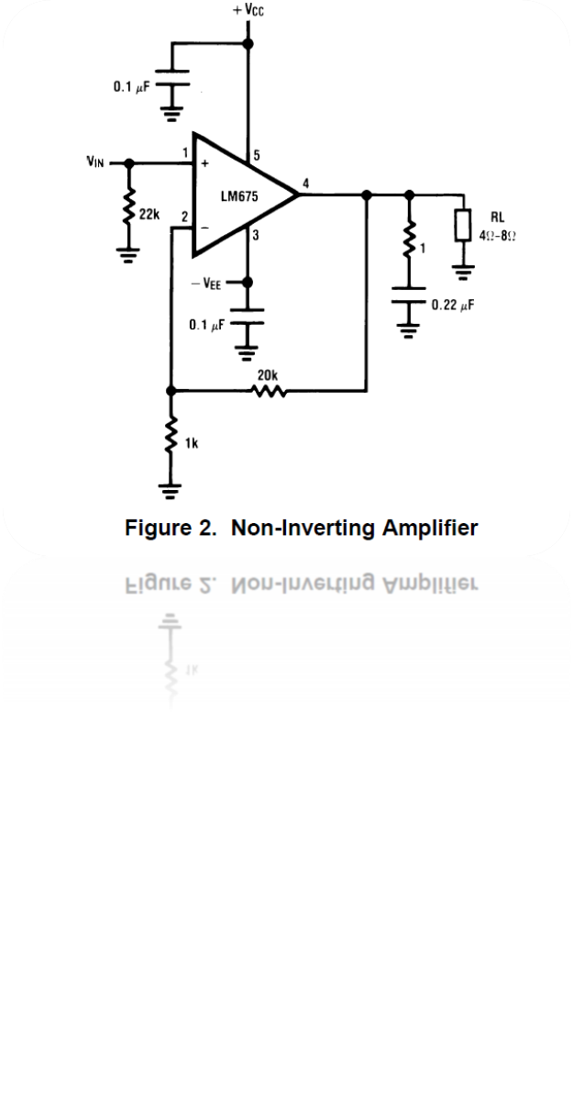
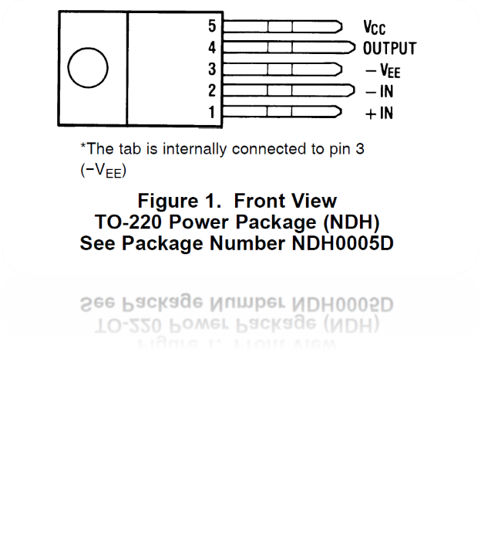

VOLTAGE SOURCE
CONNECTION DIAGRAM
TYPICAL APPLICATIONS

Slide 3
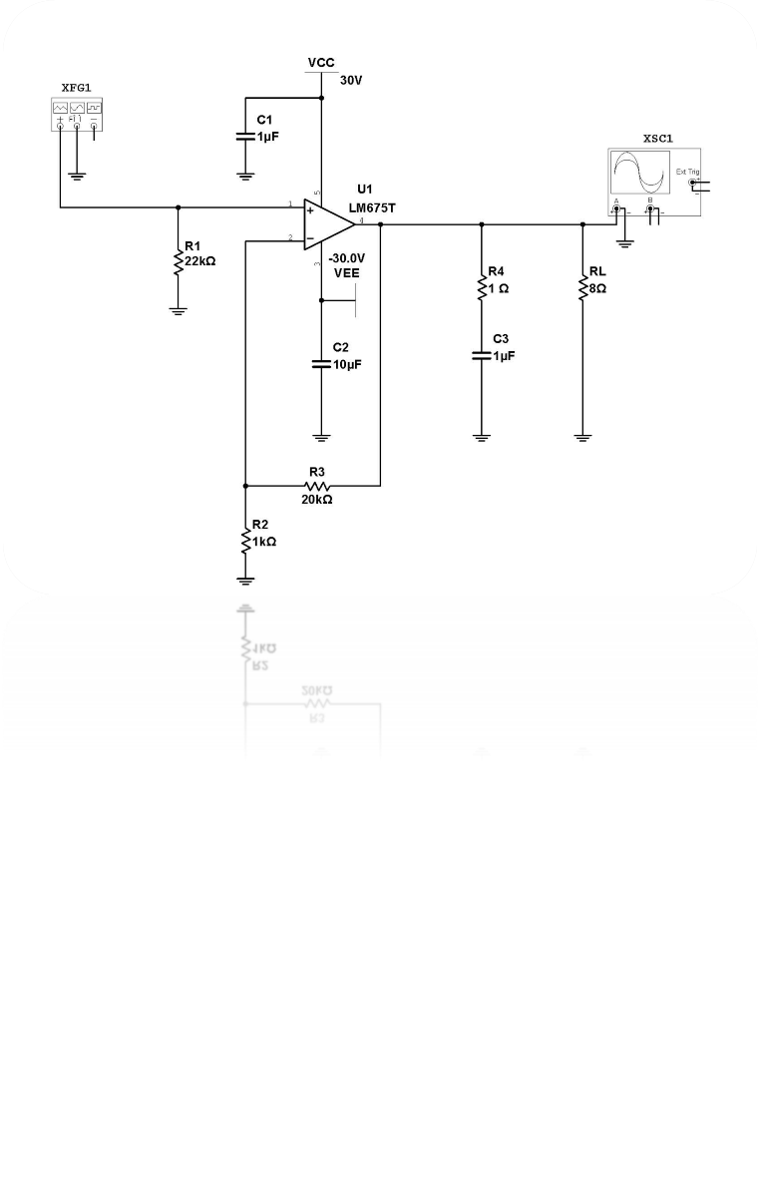
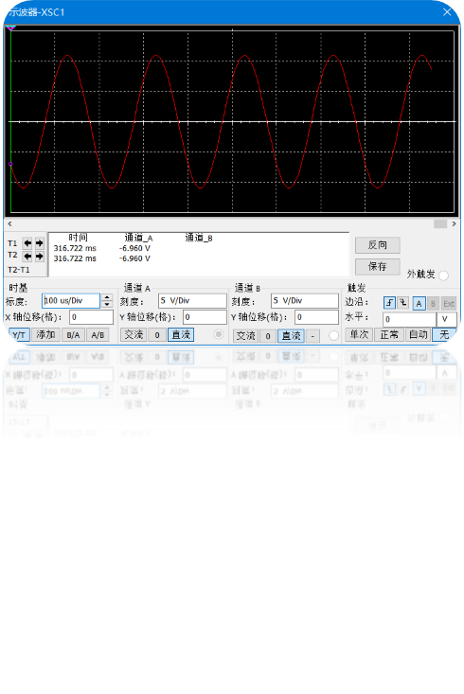
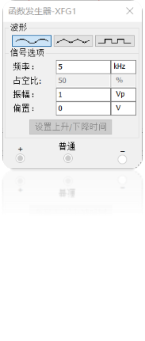
SIMULATED CHART

Slide 4

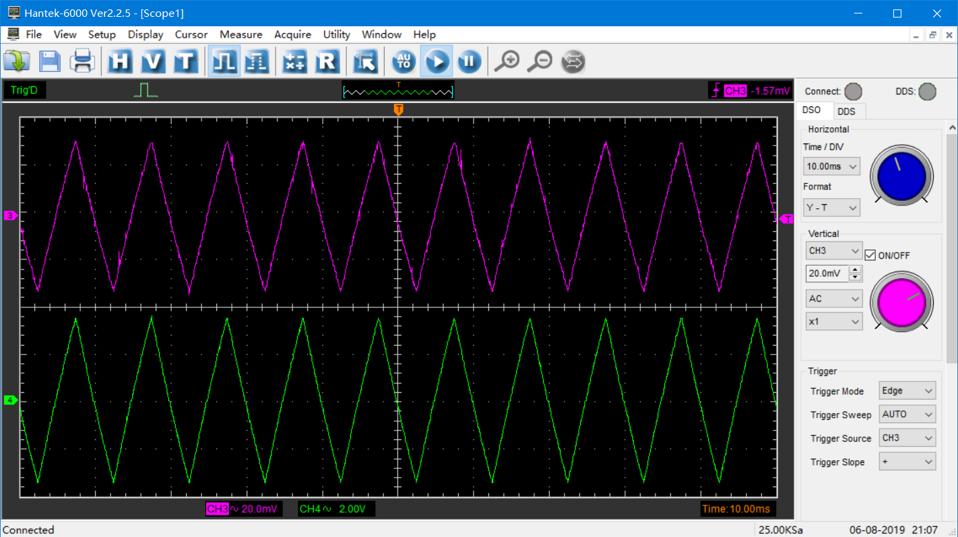

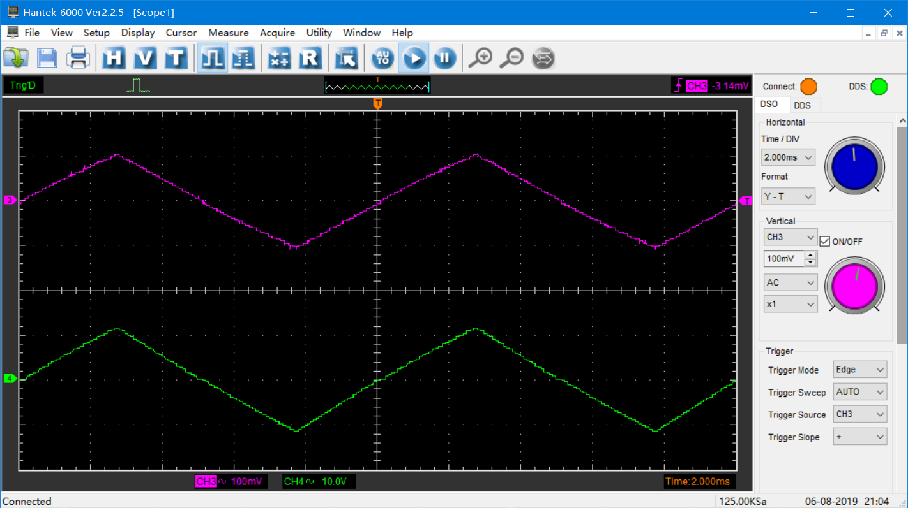
IN: 30mVpp
100HZ
OUT: 3Vpp
100HZ
IN: 100mVpp
100HZ
OUT: 10Vpp
100HZ

Slide 5
The cause of instability？
Capacitance Charge-Discharge
The voltage source is unstable
Multistage amplification is needed
Etc
AND WHY…....

Slide 6
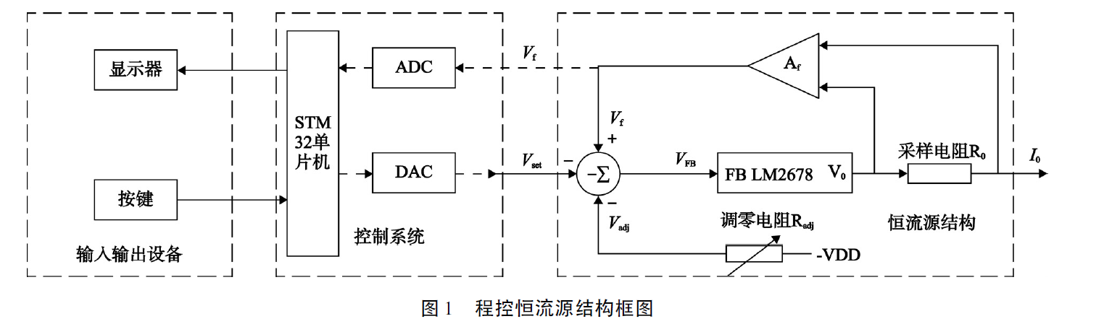
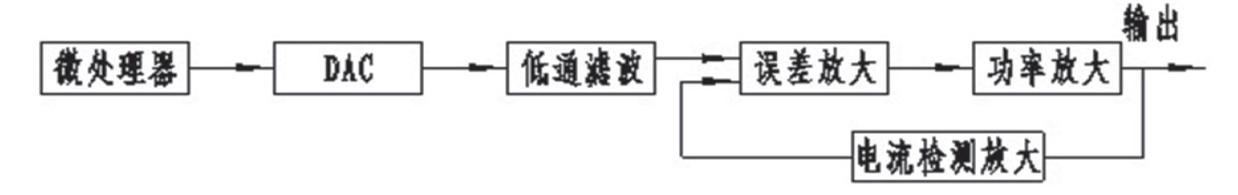
VOLTAGE SOURCE
Notes:
1.反馈放大器，lm电压转换

Slide 7
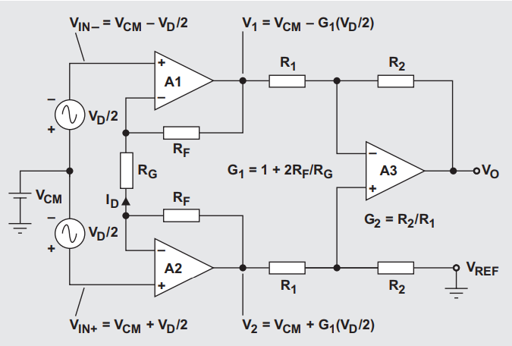
VOLTAGE SOURCE
A newer version of this device is now available: INA818
Low offset voltage: 50 µV, maximum
Low drift: 0.5 µV/°C, maximum
Low input bias current: 5 nA, maximum
High CMR: 110 dB, minimum
Inputs protected to ±40 V
Wide supply range: ±1.35 to ±18 V
Low quiescent current: 350 µA
Packages: 8-Pin plastic DIP, SO-8
Notes:
1.运放反向输入端的偏置电流,负载没有共地
2.三对大阻值精密电阻
3.opa128

Slide 8
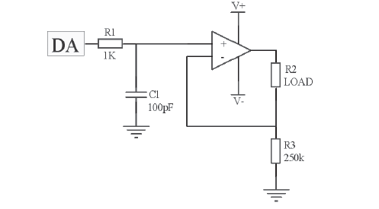
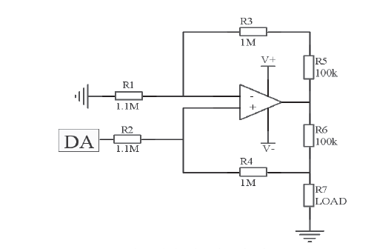
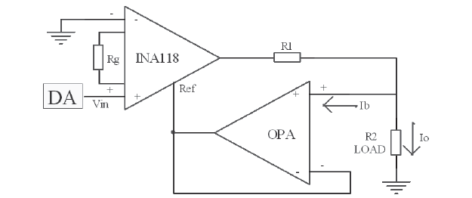
VOLTAGE SOURCE
Notes:
1.运放反向输入端的偏置电流,负载没有共地
2.三对大阻值精密电阻
3.opa128

Slide 9
VOLTAGE SOURCE
Chip Resistor
Tantalum Capacitors
OPA high impedance
NI Instruments 6356 : MCU DAC

Slide 10




